Slide 1
OOP project
Suleimenova Inkara

Slide 2
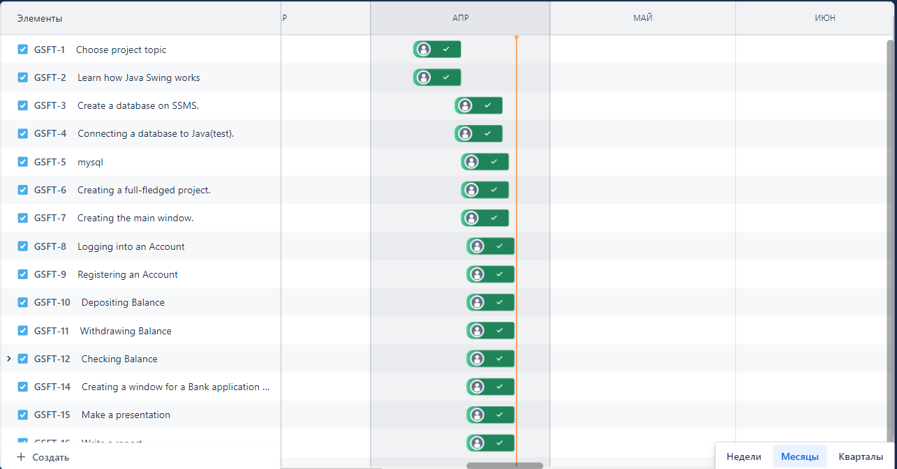
Jira

Slide 3
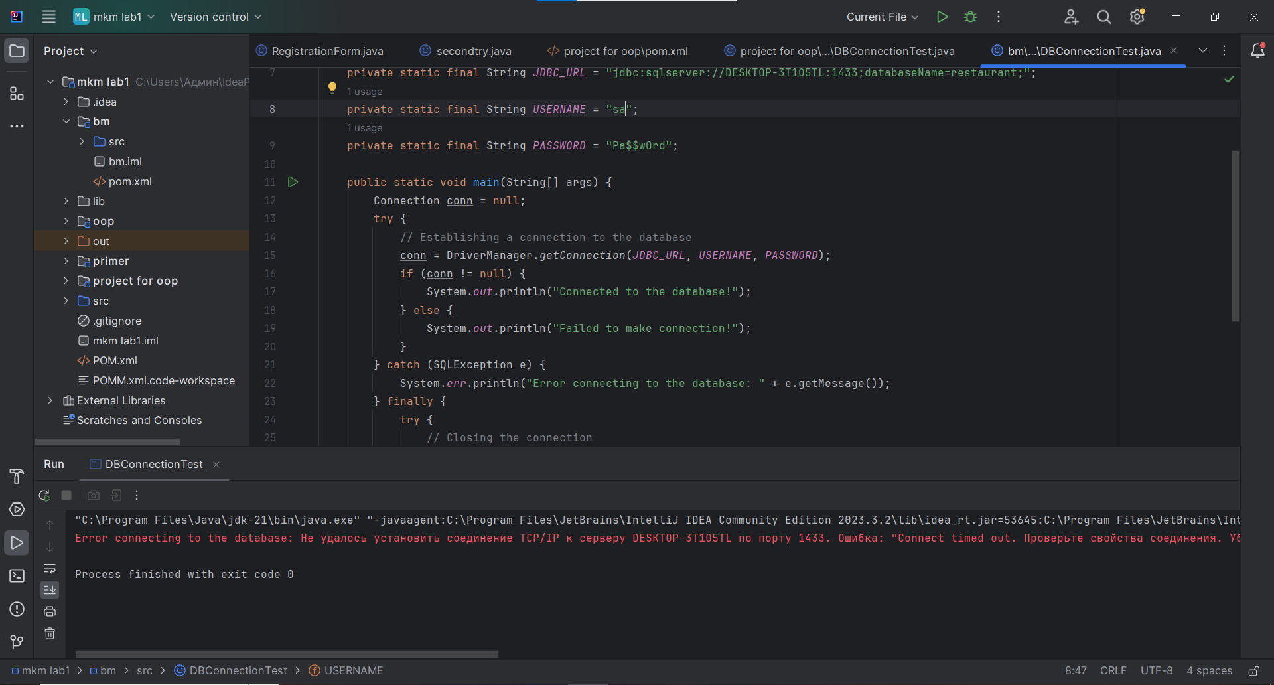
My biggest headache was that I couldn't connect the database to java.

Slide 4
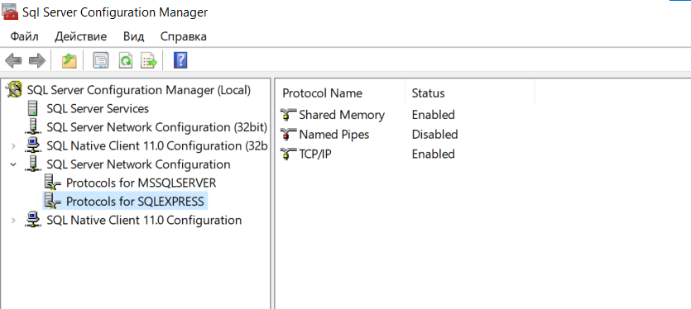
TCP/IP.Enabled

Slide 5
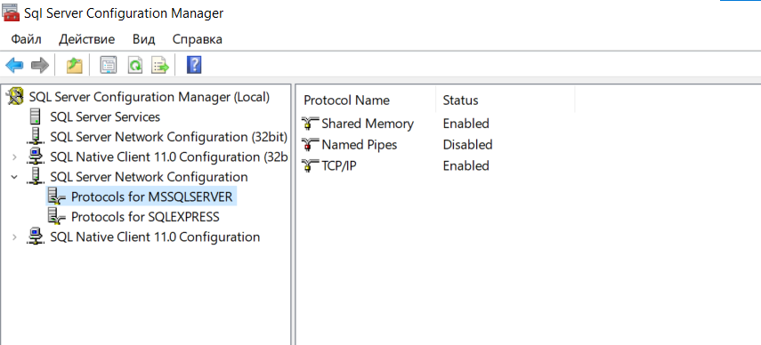
TCP/IP.Enabled

Slide 6
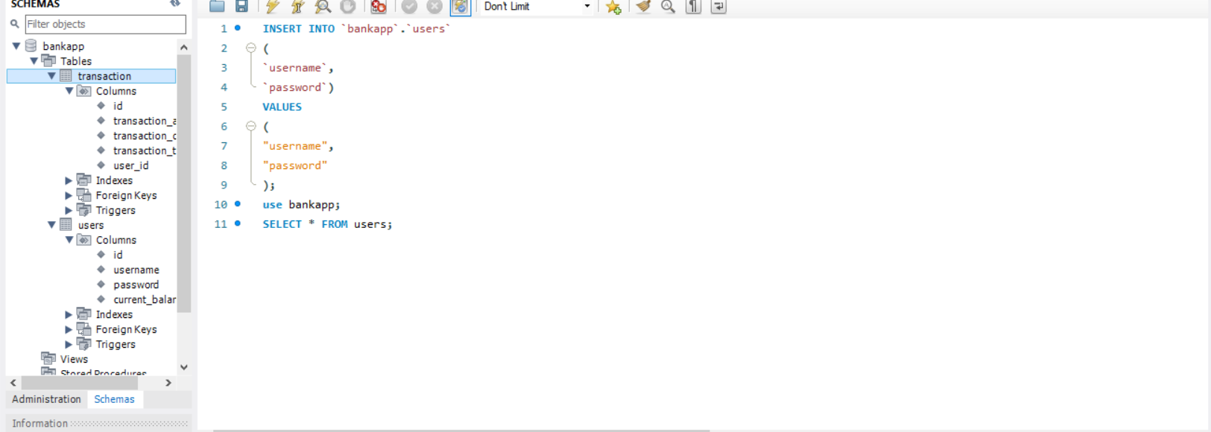
MYSQL

Slide 7
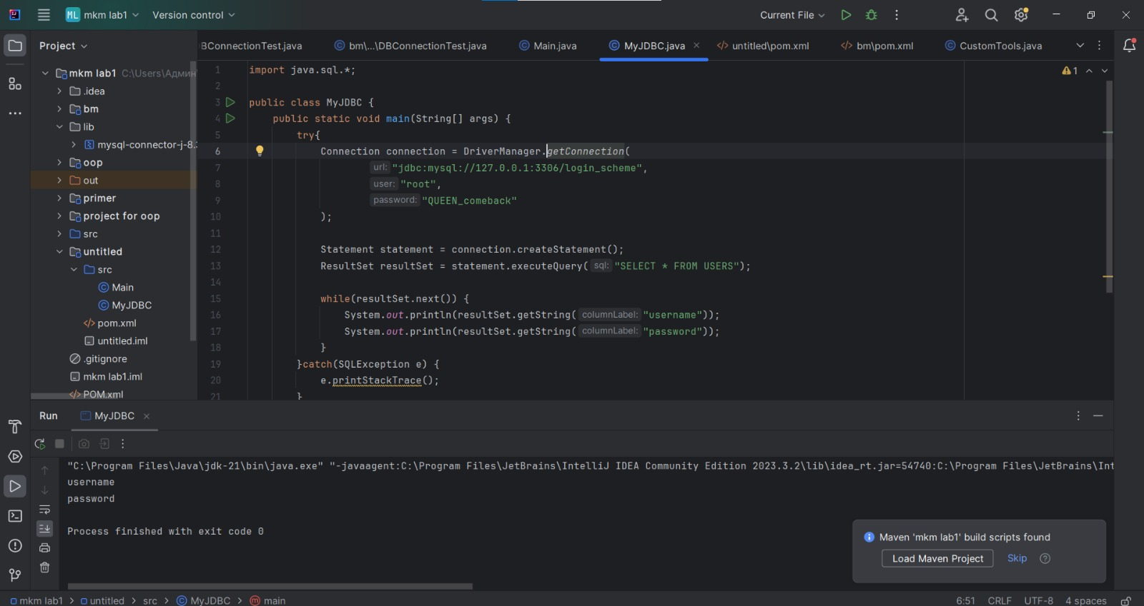
MYSQL Success connection

Slide 8
BaseFrame
Creating an abstract class helps us set up the blueprint that our Guys will follow, for example in each of the Guys they will be the same size and will need to invoke their own add GUI Components() which will be unique to each subclass. I have create an abstract class BaseFrame.

Slide 9
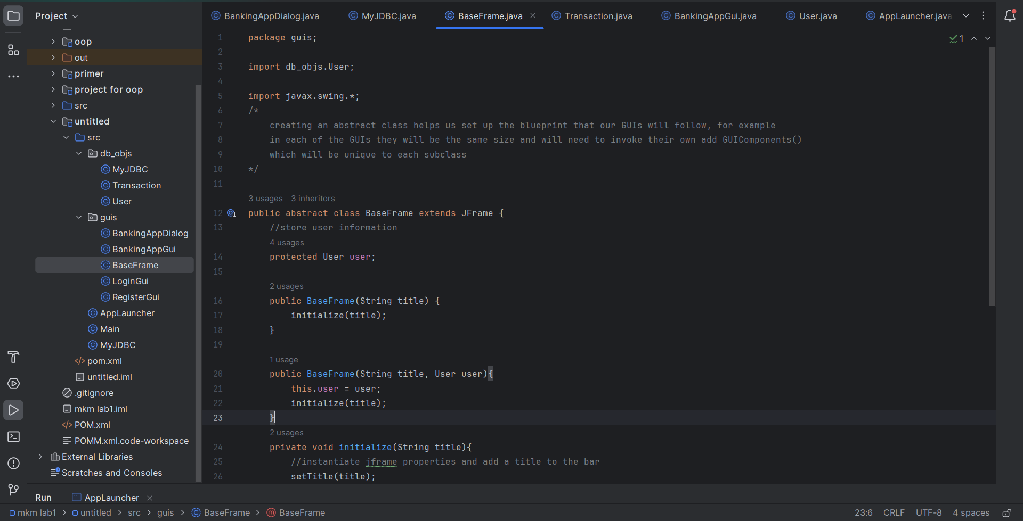
BaseFrame

Slide 10
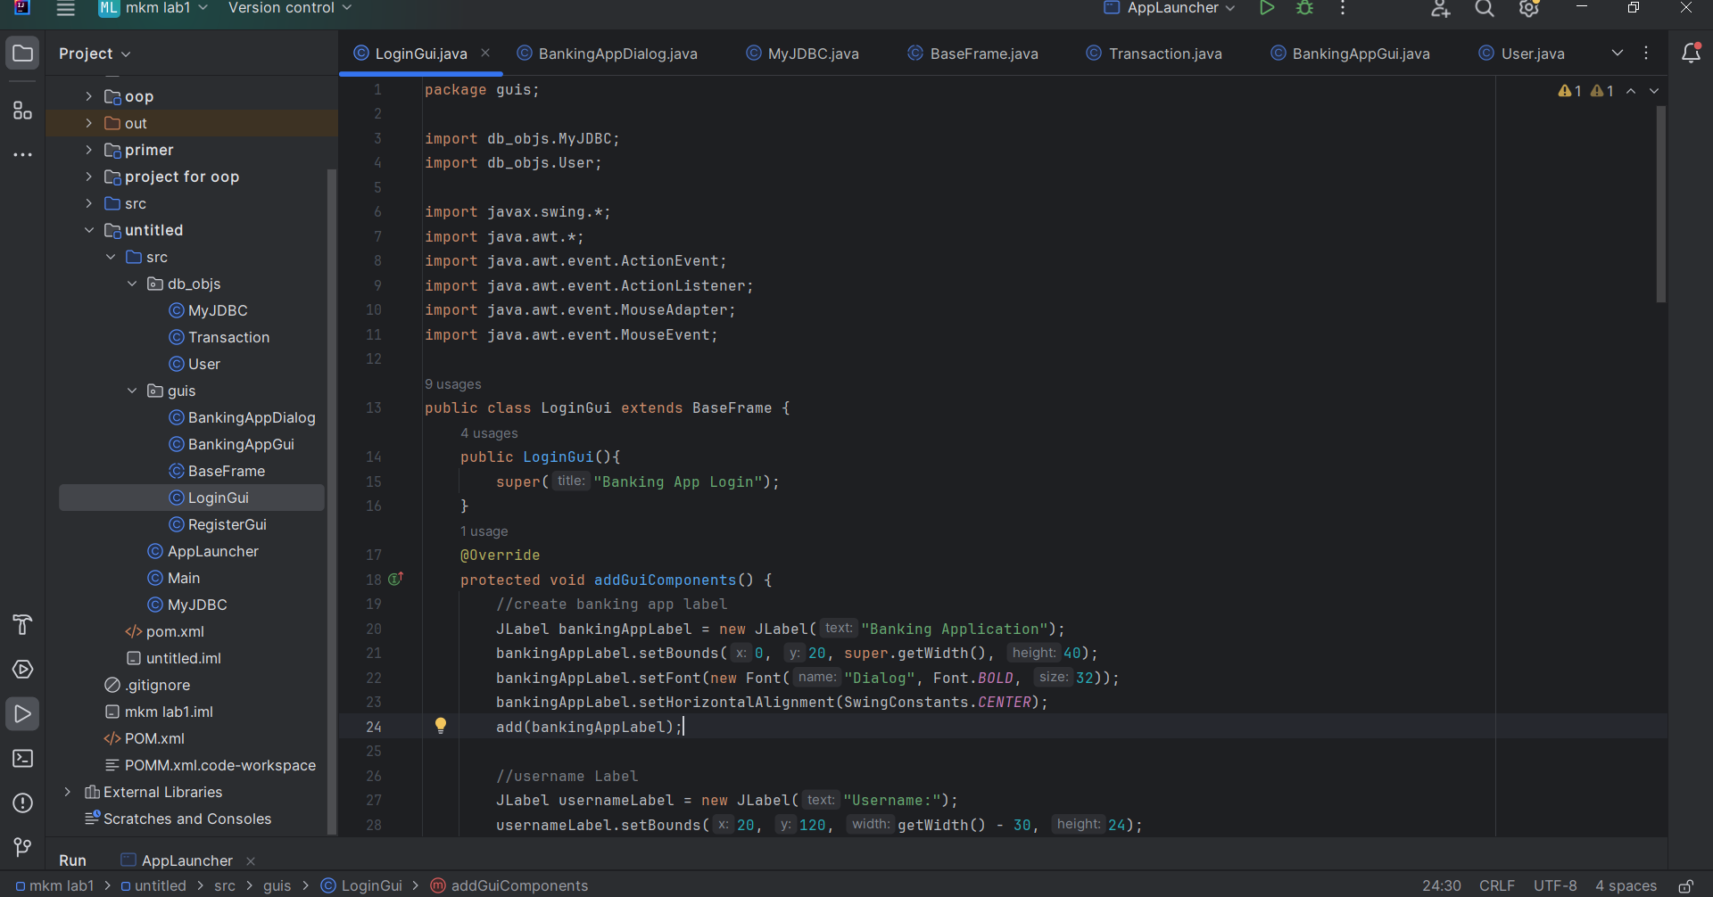
Login Gui

Slide 11
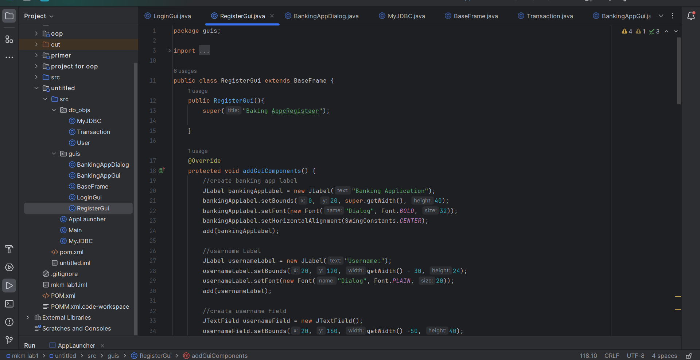
Register Gui

Slide 12
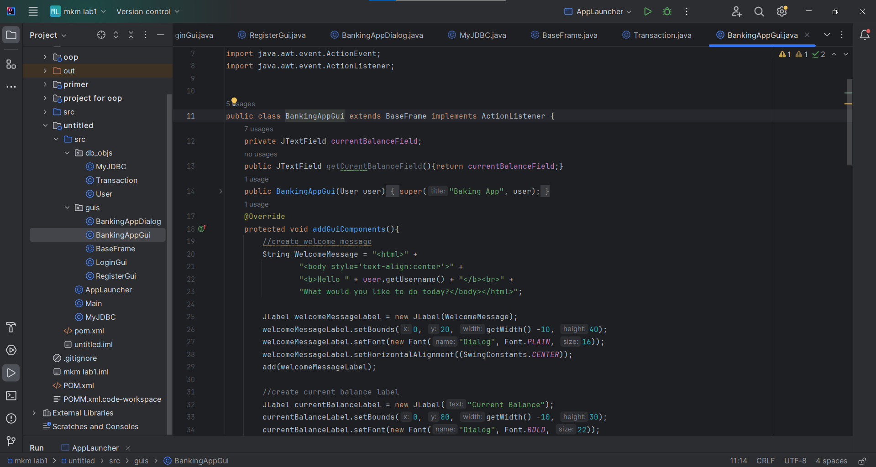
BankingAppGui

Slide 13
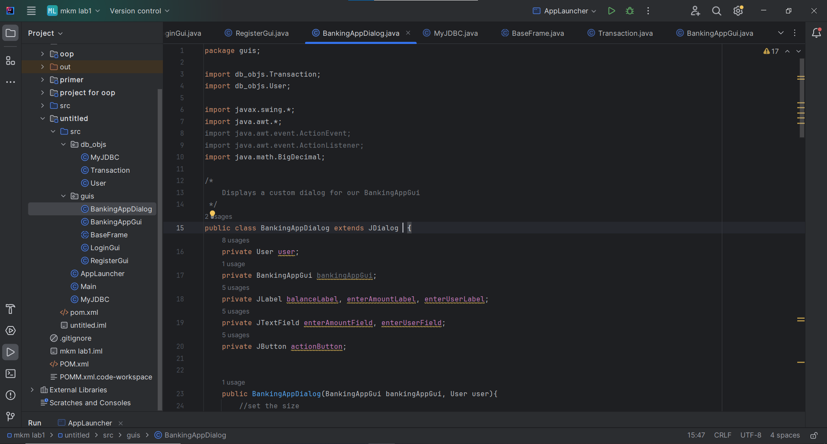
BankingAppDialog

Slide 14
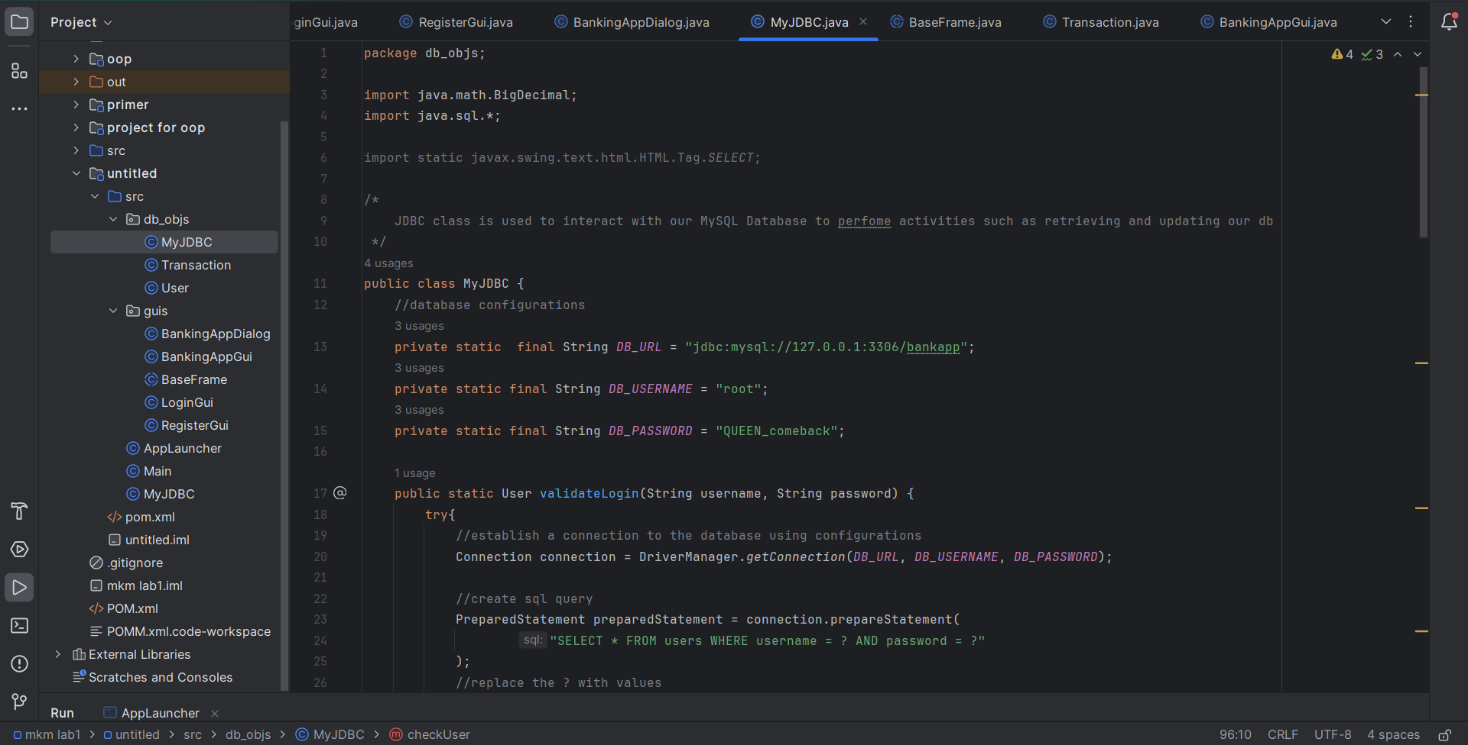
MyJDBC

Slide 15
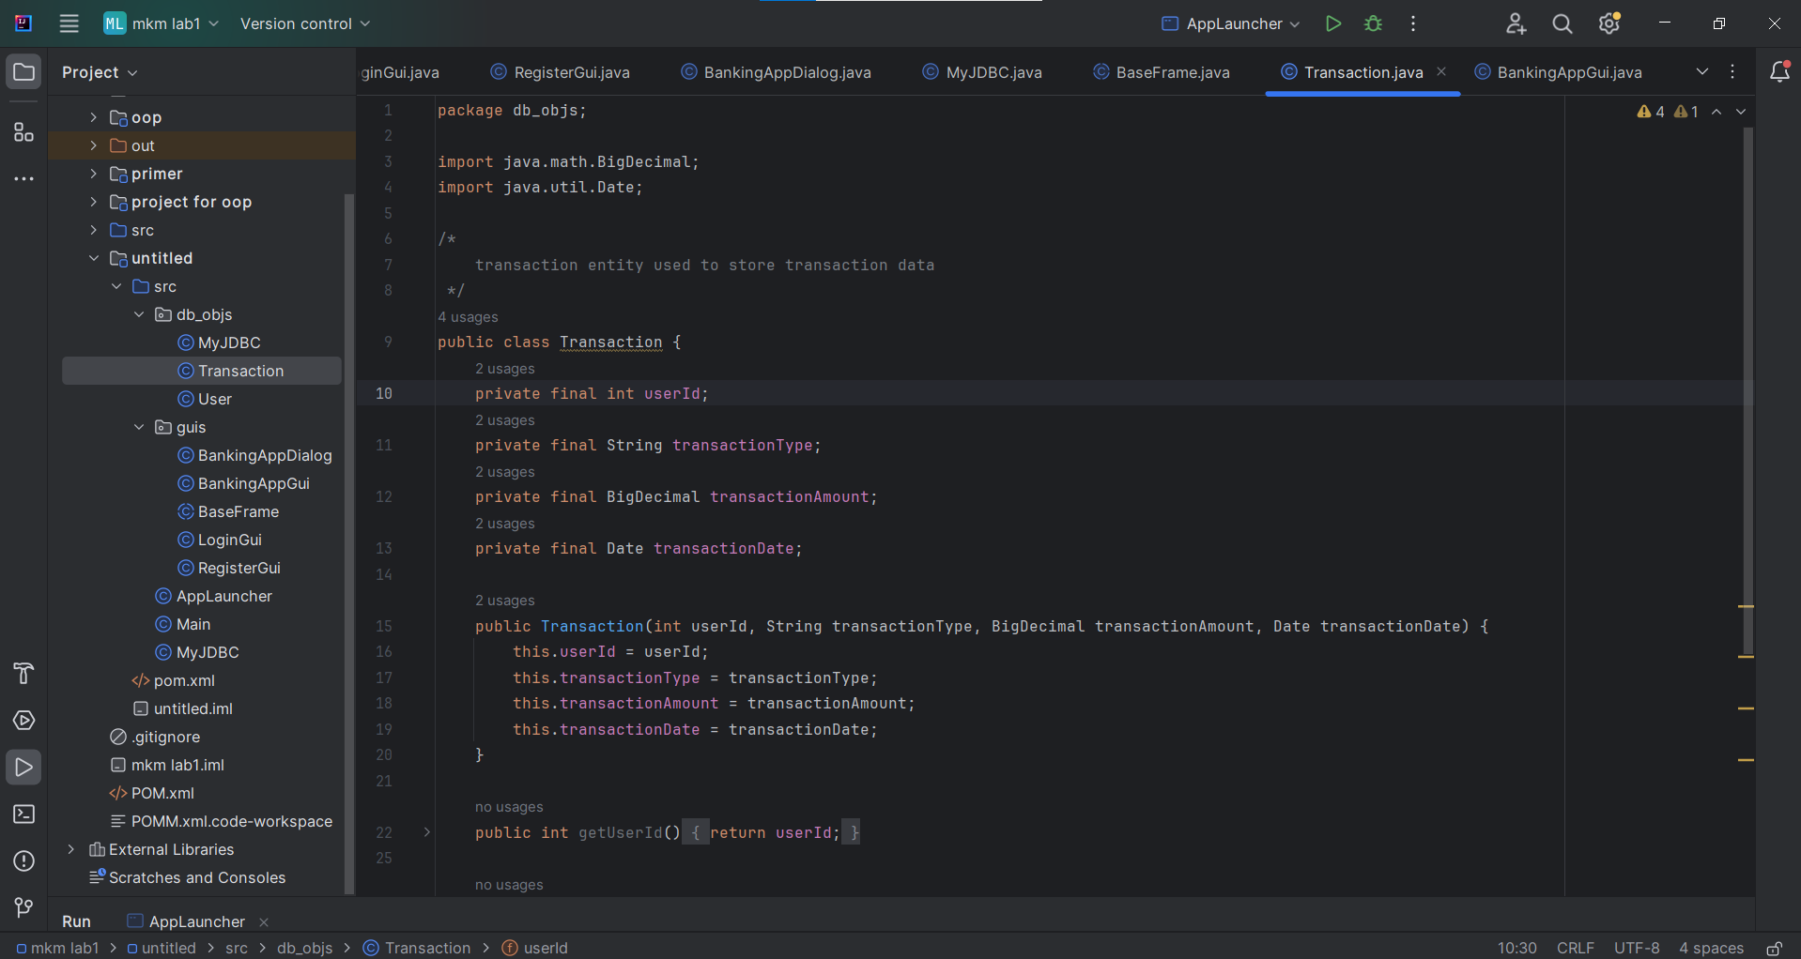
Transaction

Slide 16
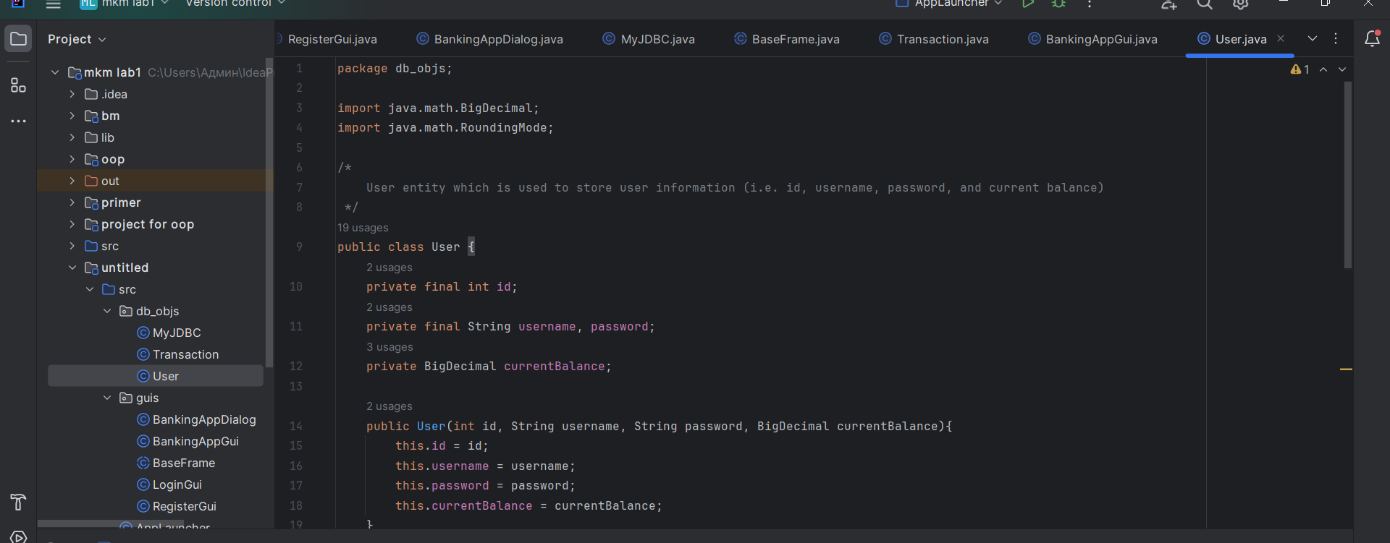
User

Slide 17
Thank you for attention!

